Slide 1

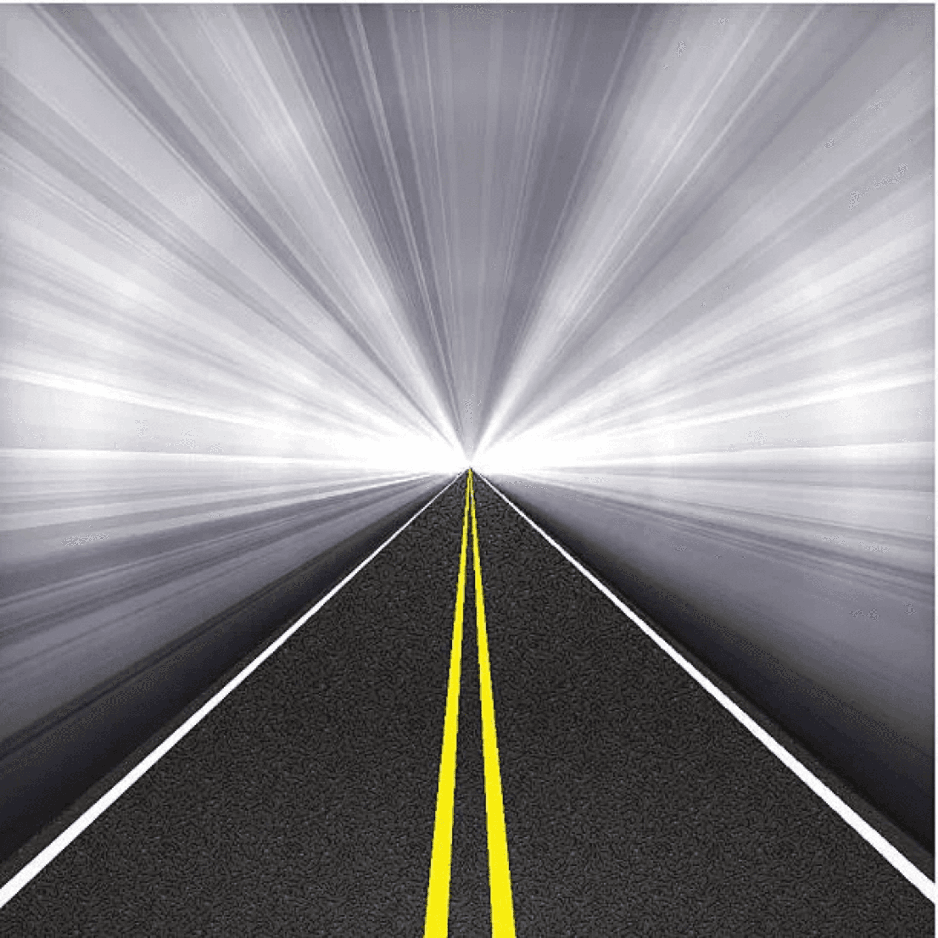
The Four Ways Speeding Impairs Drivers
Understanding the Physical and Cognitive Risks of Excessive Speed
©2026 Fatal Vision® by Innocorp, Ltd. | www.fatalvision.com

Slide 2

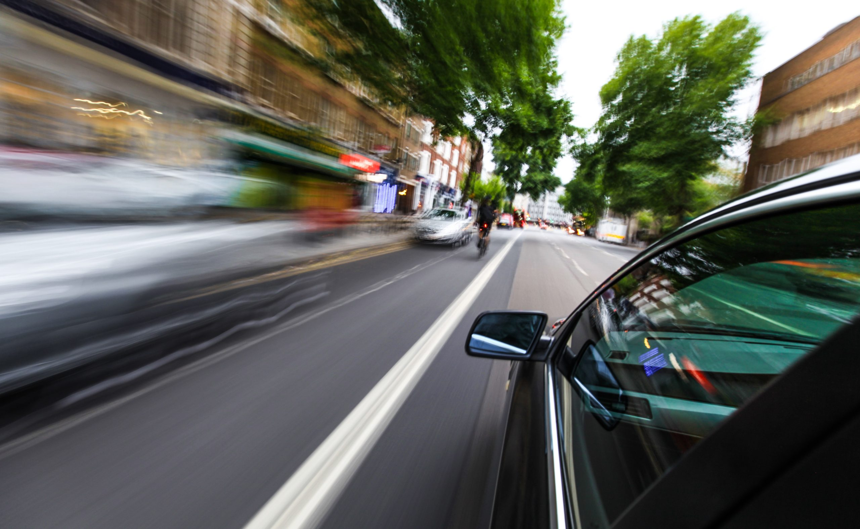
Speeding: A Threat to Physical and Cognitive Control
Speeding creates specific physical and cognitive impairments that significantly increase the danger of driving. Understanding these effects helps drivers recognize why posted speed limits exist.
1
Drivers Have a Narrower Field of Vision
2
Drivers Have Less Reaction Time
3
Vehicles Have Longer Braking Distances
4
Crashes Are More Forceful and More Likely to Be Fatal

Slide 3

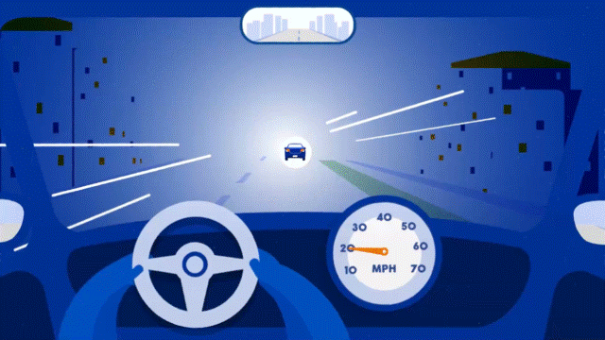
Speed-Induced Tunnel Vision:
Losing Peripheral Awareness
As speed increases, a driver's peripheral vision shrinks in a phenomenon known as "speed-induced tunnel vision." The brain focuses more on what is directly ahead, reducing the ability to detect hazards on the sides.
Field of Vision at Different Speeds
When Stopped
180°
At 35 mph (56 km/h)
104°
At 40 mph (65 km/h)
70°
At 60 mph (100 km/h)
42°
At 90 mph (150 km/h)
18° (90% reduction)

Slide 4

The Cost of Tunnel Vision: Missed Hazards
Real-World Example
A driver going 30 mph in a neighborhood can clearly see a child approaching a crosswalk from the sidewalk. At 55 mph, that child may not even register in the driver's peripheral vision until it is too late.
Discussion Questions
What kinds of hazards (pedestrians, merging cars, animals, bikes) do drivers miss when their peripheral vision is reduced?
How might tunnel vision affect driving in city streets, school zones, or heavy traffic areas?
Have you ever noticed your focus narrowing when driving fast?

Slide 5

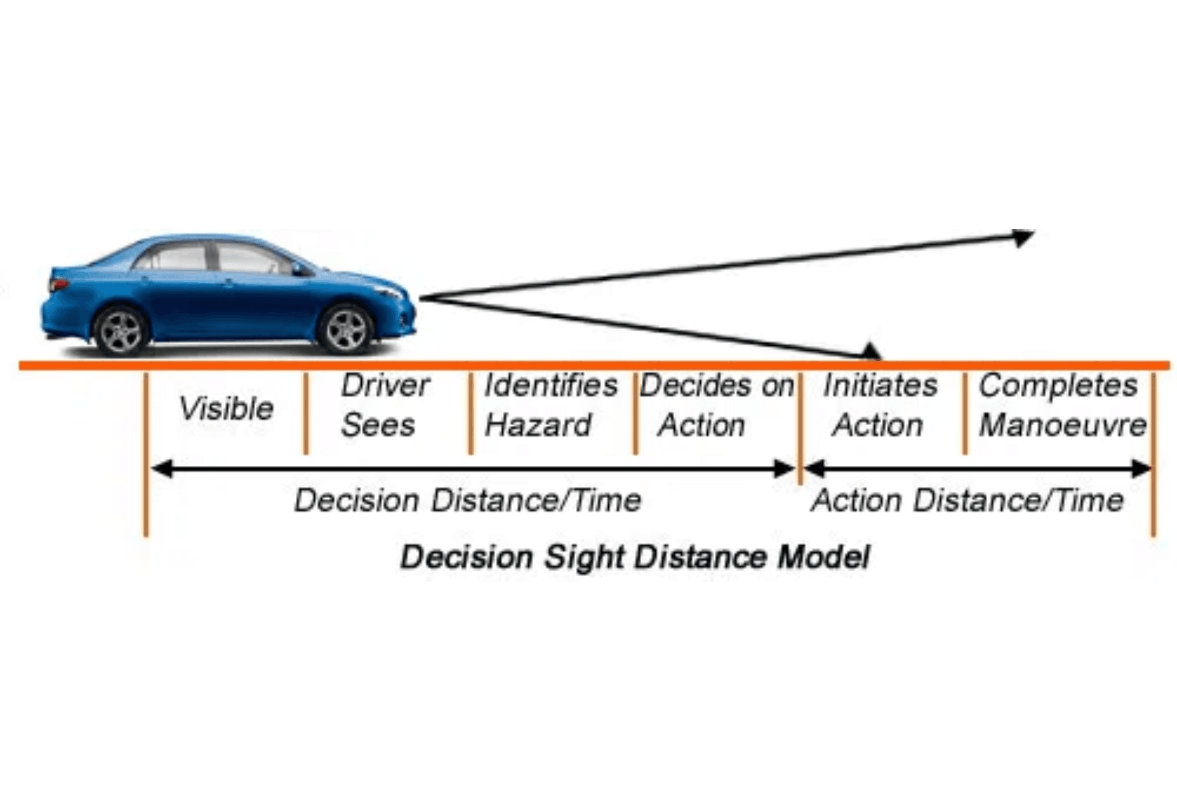
The 3.19-Second Delay: Speed vs. Response Time
Response Time =
Perception + Decision + Reaction
Speeding does not change the time it takes to process a hazard, but it drastically reduces the distance available during that time.
Average Response Time Breakdown (85% of drivers)
Eye Movement Delay
0.09s
Fixation Delay
0.20s
Recognition Delay
0.50s
Decision Time
0.85s
Muscle Response Delay
0.31s
Brake Reaction Time
1.24s
Total Response Time
3.19 seconds

Slide 6

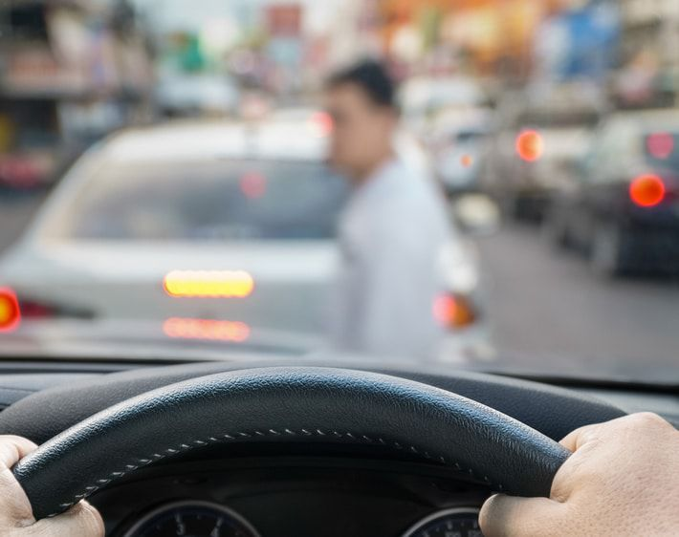
The Seven Steps to a Stop: Where Errors Can Occur
The process from detecting a hazard to pressing the brake pedal involves seven distinct steps. When speeding, the vehicle covers far greater distance during this process, leaving less margin for error.
The Seven Steps
1.
The eyes detect the object
2.
The optical signal is converted into a nerve impulse
3.
The signal travels to the brain's visual cortex
4.
The brain interprets the object as a hazard
5.
The brain decides what action to take
6.
A motor signal is sent to the leg muscles
7.
The foot moves to press the brake pedal
Discussion Question:
Why is speeding especially dangerous in unfamiliar areas or during night-time driving, where the time needed for perception and decision is naturally extended?

Slide 7

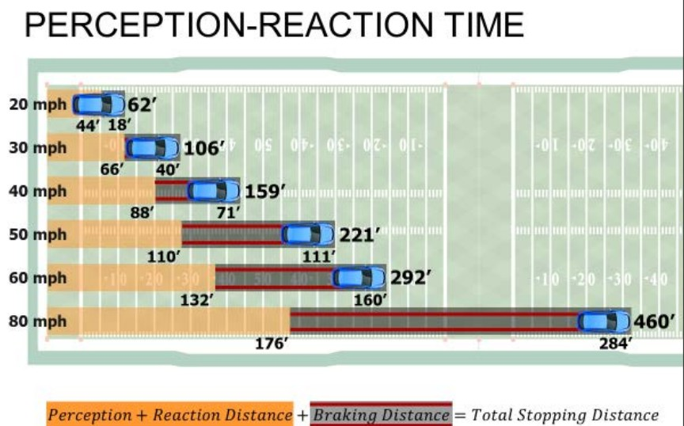
Exponential Increase: Stopping Distance vs. Speed
Stopping distance increases exponentially, not linearly, as speed rises because kinetic energy grows with the square of speed.
Stopping Distance = Response Distance + Braking Distance
Doubling a car's speed requires approximately 3 to 4 times the distance to come to a stop.
At 30 mph on dry pavement
75–120 feet
At 60 mph on dry pavement
240–360 feet
Comparison
3–4x longer
Note: At 60 mph, stopping distance is almost the length of a football field.

Slide 8
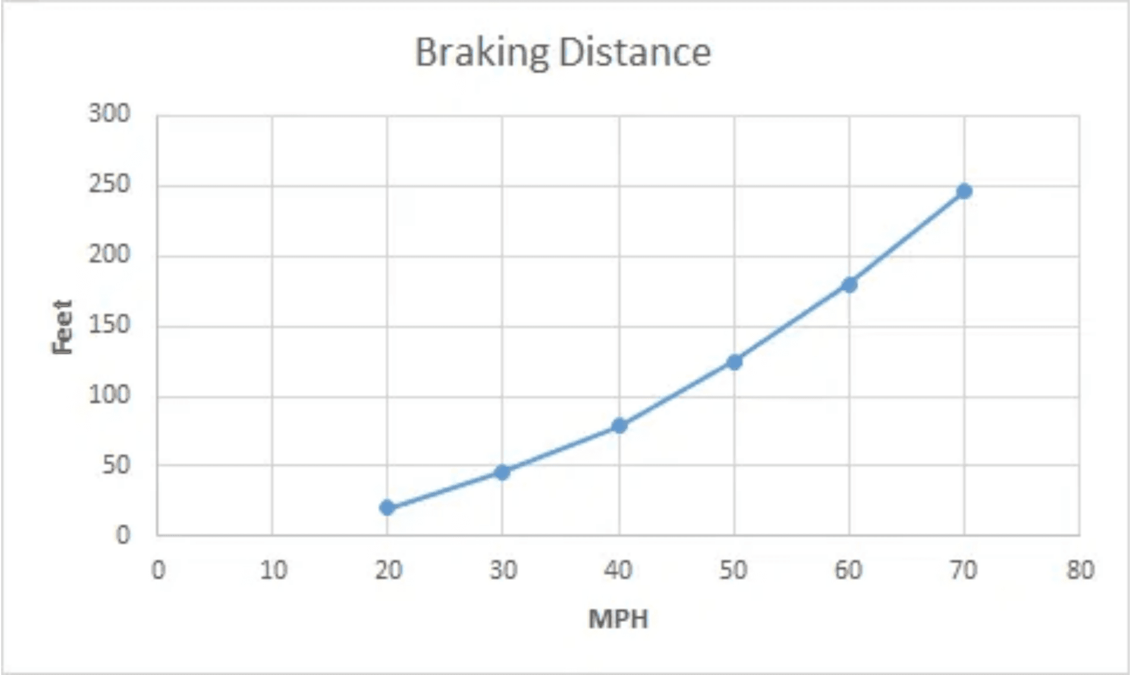
Factors That Compound Braking Distance
Discussion Question 1
What kinds of road conditions and vehicle factors make braking distances even longer?
• Road conditions: rain, gravel, ice, snow
• Vehicle factors: tire condition, vehicle weight, brake quality
• Environmental factors: road incline/decline, wet surfaces
Discussion Question 2
How does tailgating combined with speeding dramatically increase crash risk?
• No margin for error when following too closely
• Reduced reaction time to sudden stops
• Especially dangerous on curves, hills, and limited visibility areas

Slide 9

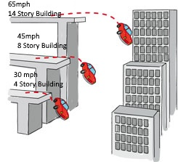
Crash Force: The Square of Speed
Higher speeds mean dramatically greater crash forces. Just as with braking distance, kinetic energy increases with the square of speed, making collisions far more severe and often unsurvivable.
Doubling speed results in 4 times the crash energy
Impact Force Analogy
30 mph (50 km/h)
Fall from 4-story building
45 mph (75 km/h)
Fall from 8-story building
65 mph (100 km/h)
Fall from 14-story building

Slide 10

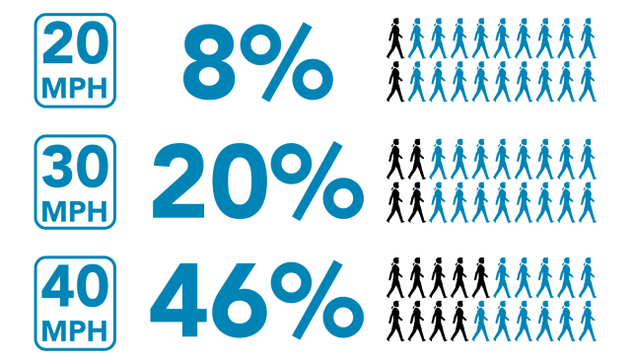
Safety Limits and Unsurvivable Speeds
Real-World Collision Scenarios
Collision at 30 mph
May result in injuries, but typically survivable conditions with modern safety features.
Collision at 70 mph
Can be unsurvivable, even with modern vehicle safety features (airbags, crumple zones).
Safety features have limits. Beyond a certain speed threshold, these protective systems cannot adequately protect occupants from the extreme forces generated in a collision.
Likelihood of death for people walking if hit at these speeds
Source: AAA Foundation, Tefft, B.C. (2011)
Discussion Question
How do higher speeds affect not just the driver, but also passengers, pedestrians, and people in other vehicles?

Slide 11
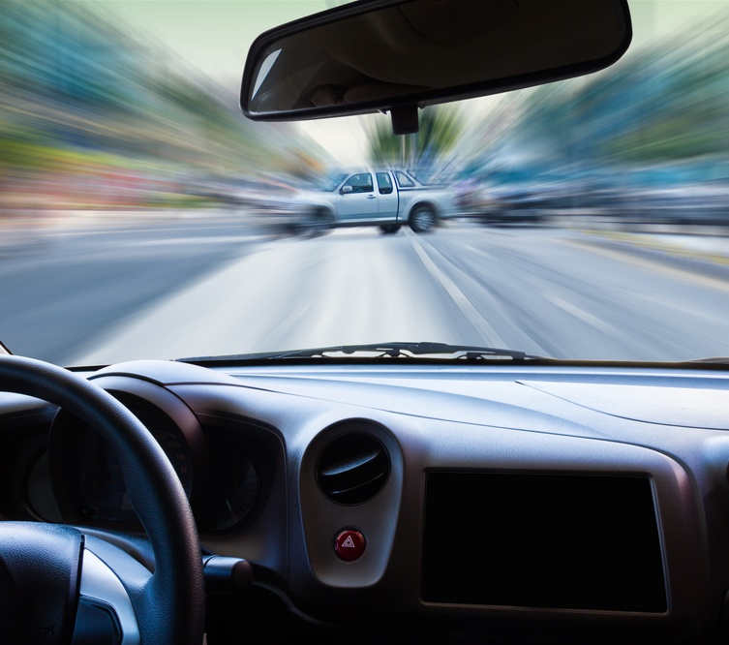
Summary: Speeding's Unacceptable Trade-Offs
1
Vision
You lose peripheral vision, missing critical side hazards like pedestrians and merging cars.
2
Reaction Time
You cover more distance during the average 3.19-second response time, eliminating your margin for error.
3
Stopping Distance
Your stopping distance increases exponentially (3–4x when doubling speed).
4
Crash Force
Your crash energy increases by the square of your speed (4x when doubling speed), making crashes more fatal.

Slide 12

Drive Smart, Drive Safe
Speed limits are set to account for human limitations and vehicle physics. Respecting them is the single most effective way to mitigate the four impairments discussed. Every mile per hour matters when it comes to your safety and the safety of others on the road.
Final Reflection
What is one change you can commit to making in your driving habits to reduce the risk associated with speeding?

