Slide 1

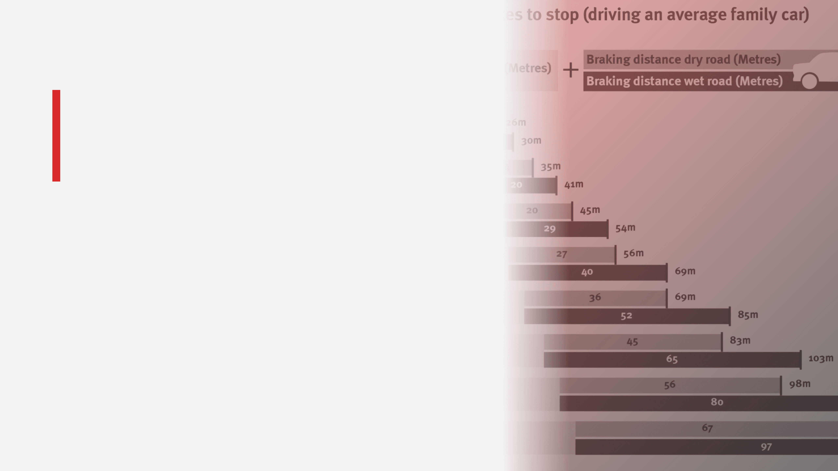
Does Speeding
Save Meaningful
Time?
Contrasting Perceived Gains with Real-World Data and Risks
©2026 Fatal Vision® by Innocorp, Ltd. | www.fatalvision.com

Slide 2


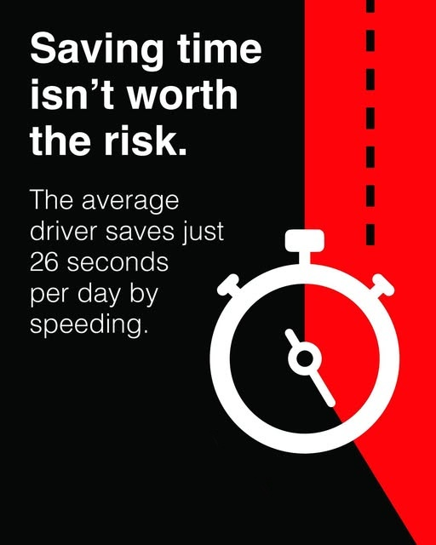
Research Insights: Quantifying Time Savings
Click to watch video
Key Takeaway
Increasing speed does not reduce travel time when you include traffic flow, signals, road conditions, and congestion.

Slide 3

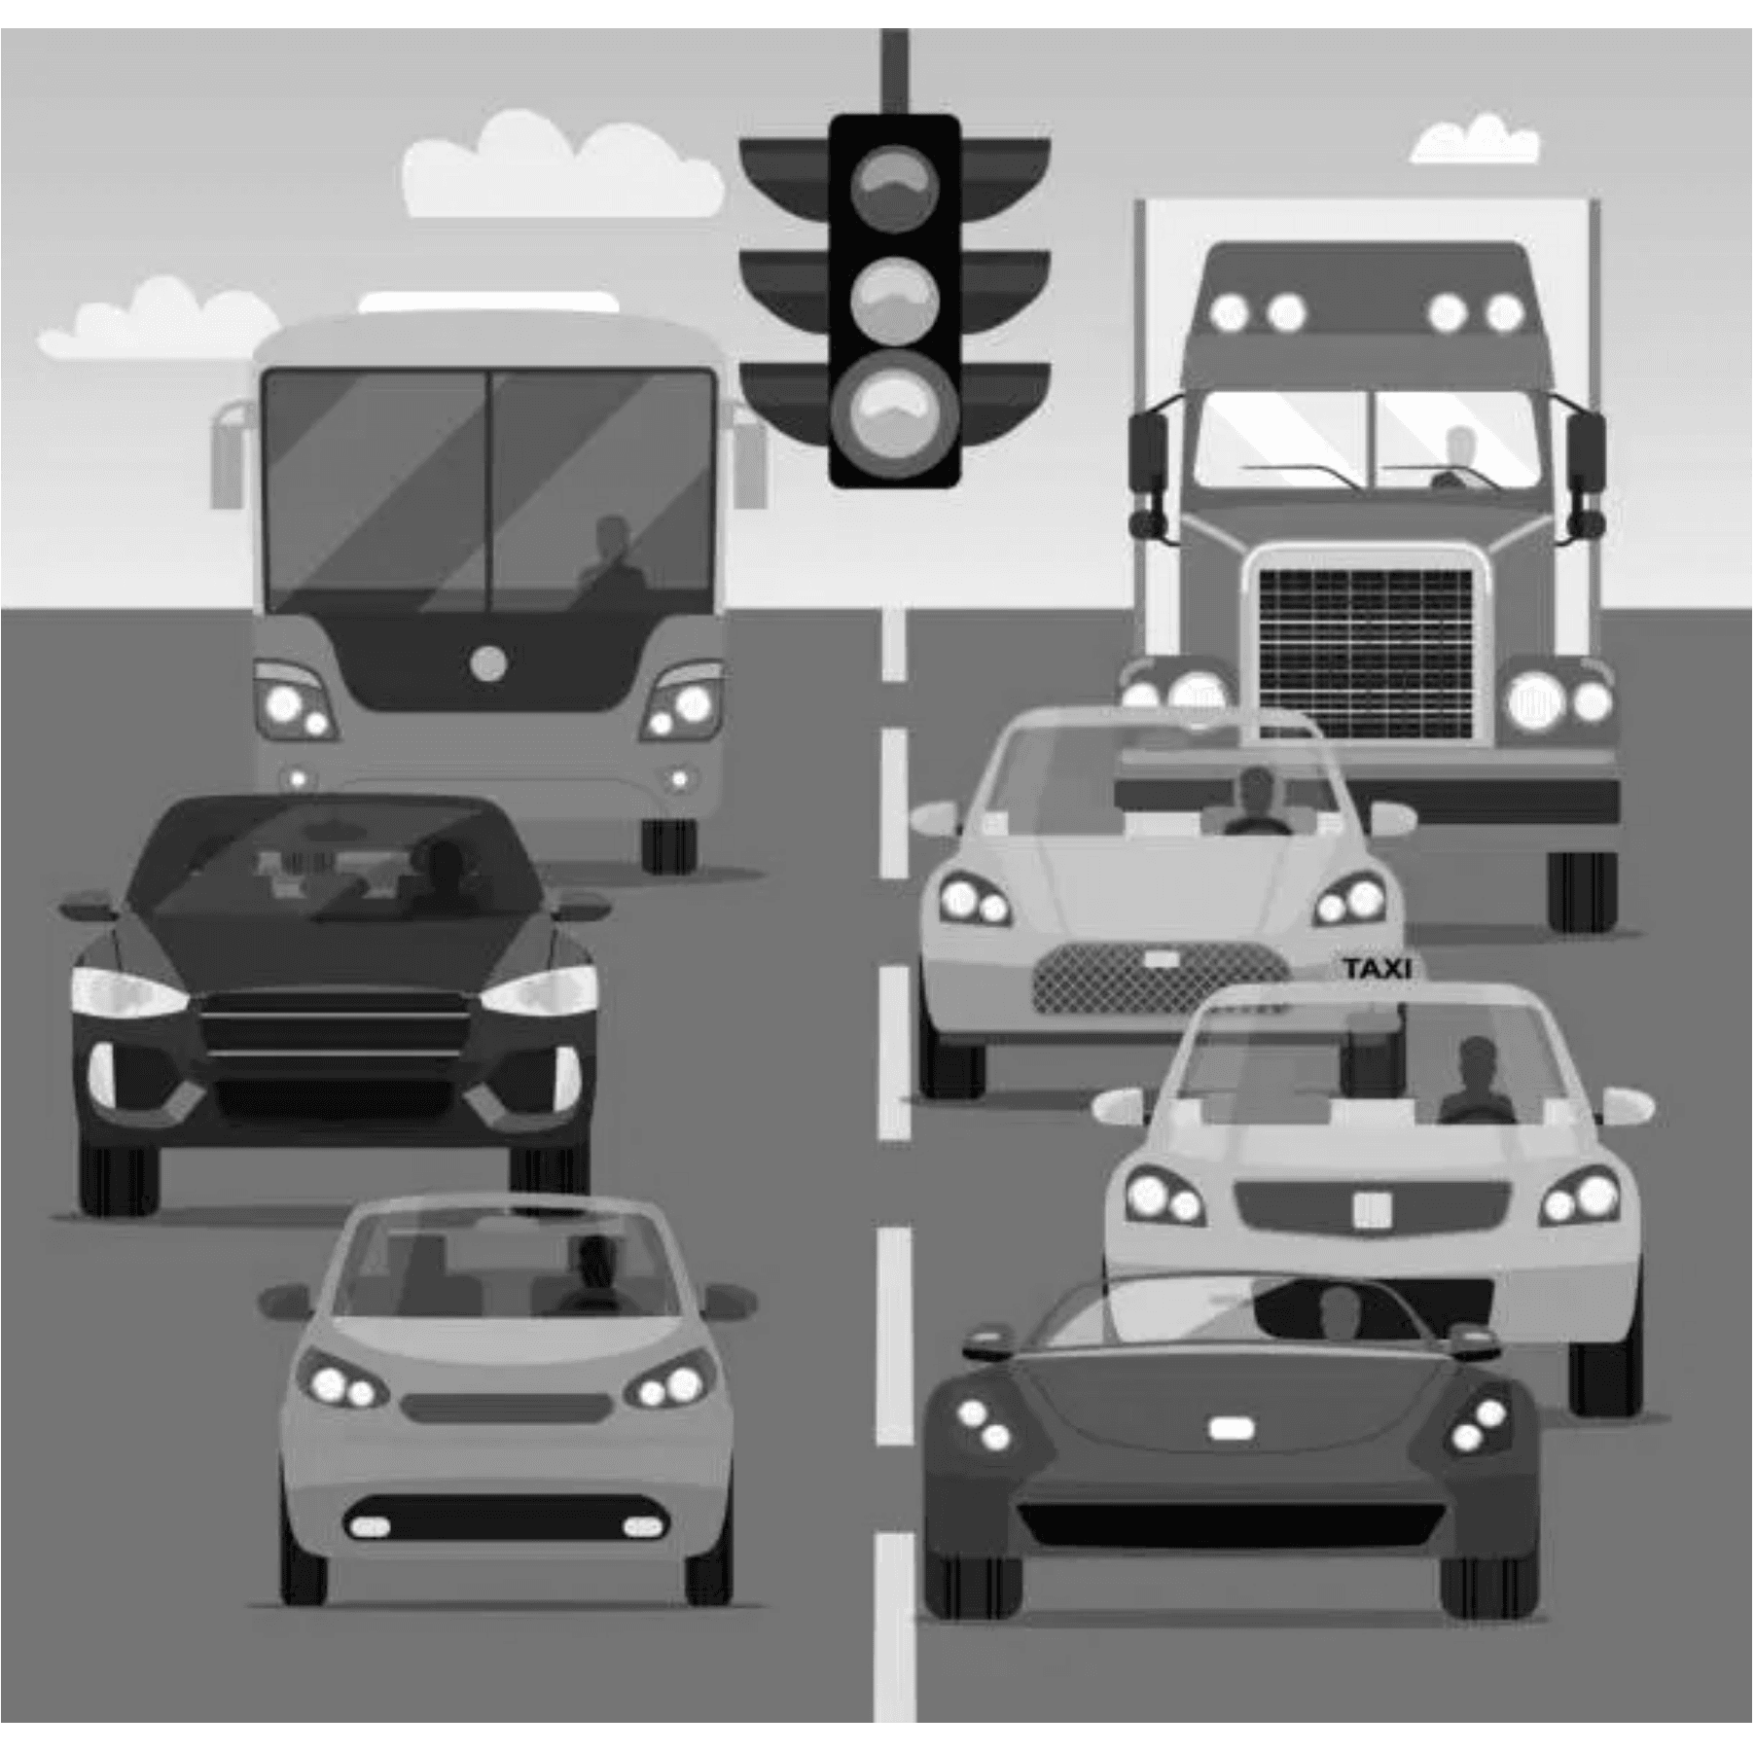
Real-World Barriers to Time Savings
Congestion
In heavy traffic, speeds collapse toward the average regardless
of the posted limit.
Infrastructure
Traffic signals and stop signs diminish speed gains between
intersections.
Speed Variability
Faster drivers frequently encounter slower traffic, reducing
the effective top speed.
Safety Margins
Higher speeds require larger gaps and more cautious following,
negating the perceived time saved.

Slide 4

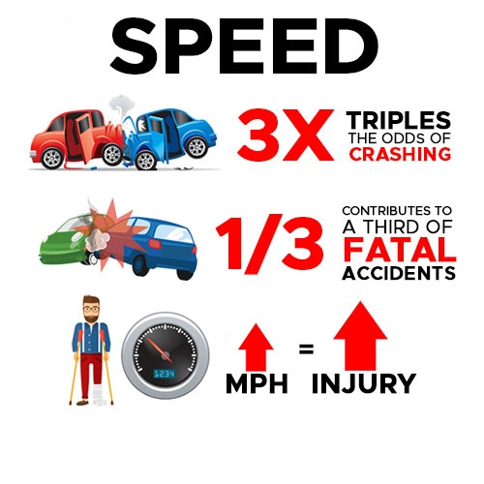
The Exponential Increase
in Crash Risk
Every 1 mph Increase
Raises crash risk by 3% and injury crash risk by 4–5%.
Exponential Fatality Risk
Fatality risk increases dramatically with speed; survivable crashes quickly become deadly.
2020 U.S. Statistics
Speeding was a factor in 29% of all traffic fatalities, resulting in over 11,000 lives lost in a single year.

Slide 5
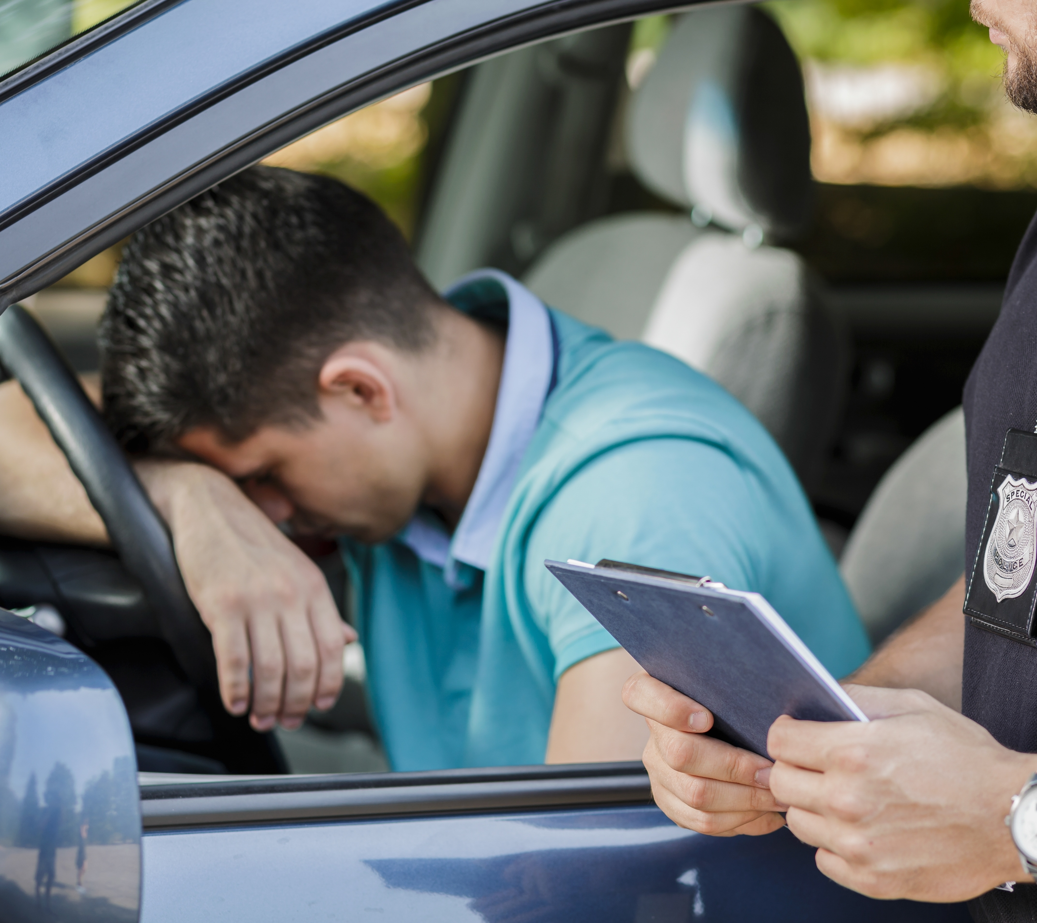
Hidden Financial and
Vehicle Costs
Fuel Consumption
Driving at 75 mph instead of 65 mph can reduce fuel economy by 15% to 20%.
Annual Financial Loss
Speeding can add over $400 in annual fuel costs for the average driver.
Vehicle Wear & Tear
Higher speeds lead to greater mechanical stress and more frequent insurance claims.
Speeding-related crashes cost the economy approximately $40.4 Billion every year.

Slide 6

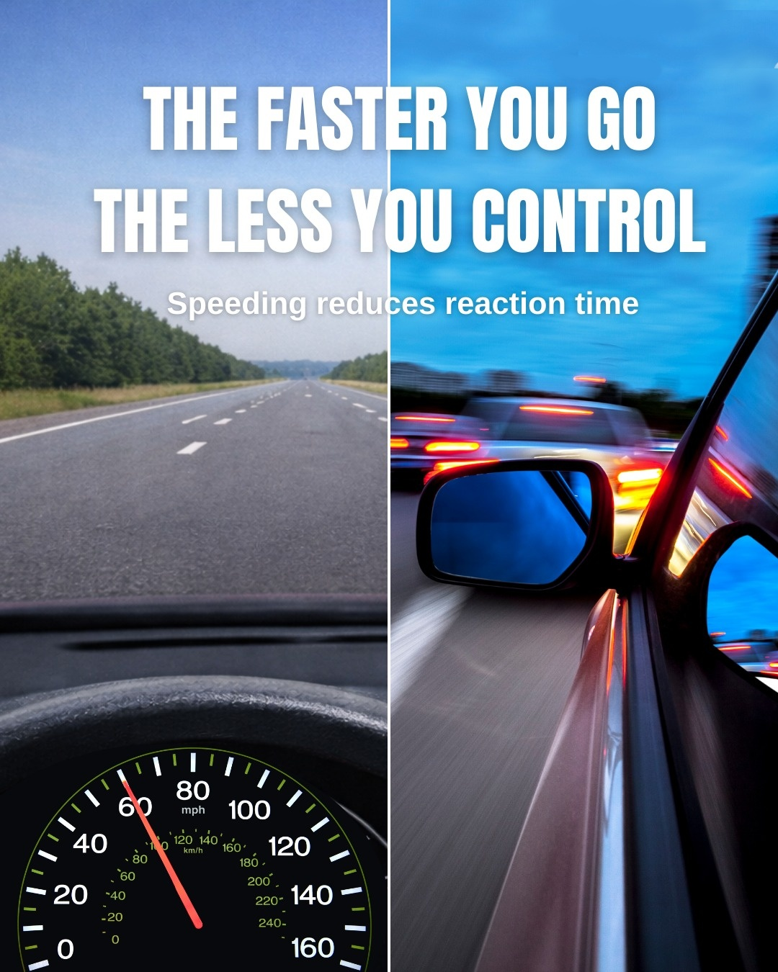
Driver Performance Loss at High Speeds
Reaction Time
Visual Field
Less time to identify hazards and execute evasive maneuvers.
Peripheral vision narrows as speed increases, creating a loss of awareness.
Braking Distance
Impact Force
Stopping distances increase exponentially.
Crashes at higher speeds are far more forceful, more likely to be fatal.
Speed impairs the driver's ability to avoid a crash and increases the severity of the crash when it occurs.

Slide 7
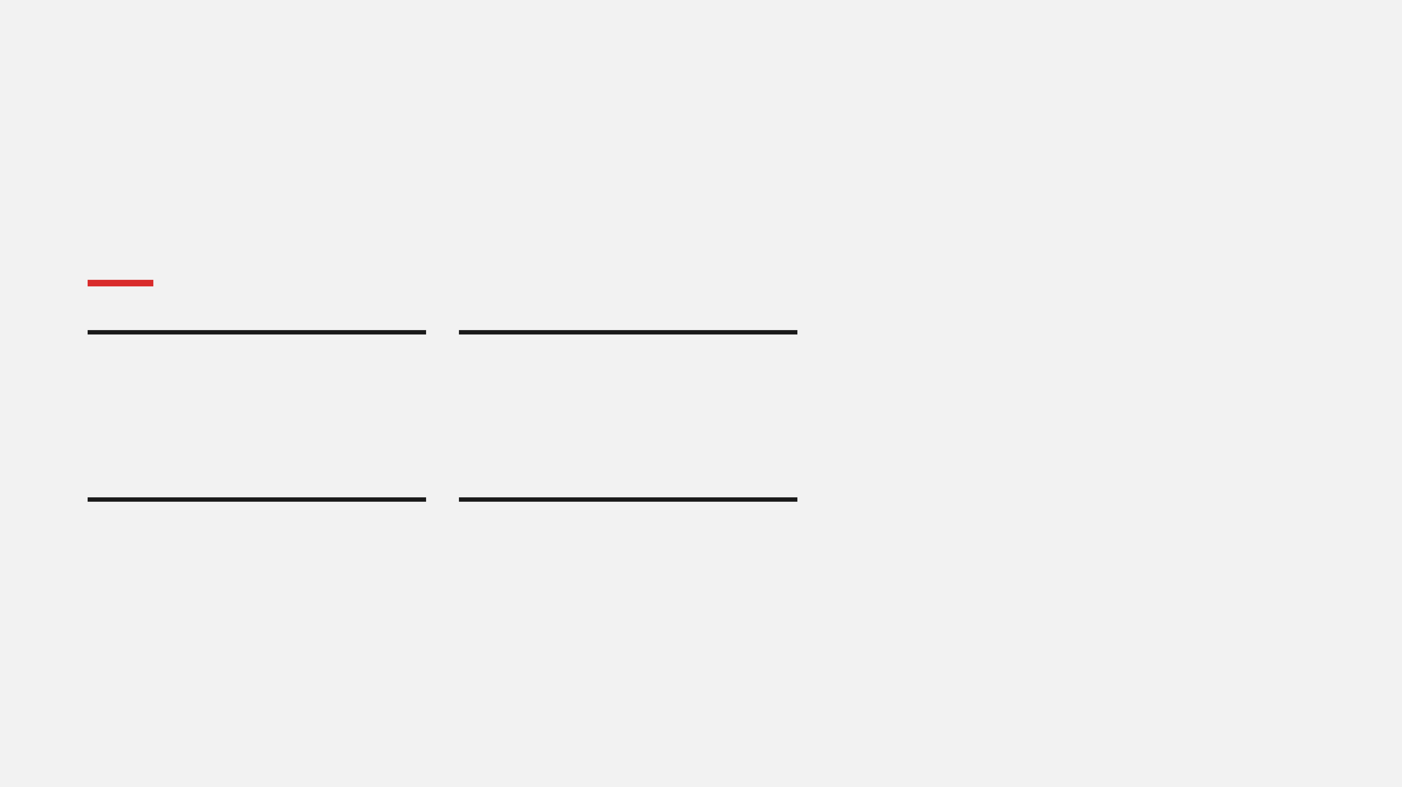
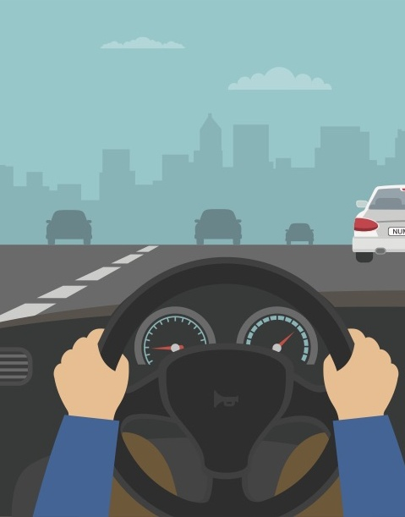
Smarter Alternatives to Speeding
Navigation Tools
Time Management
Use GPS apps to identify real-time traffic congestion and construction, allowing for more efficient route planning.
Leave 10–15 minutes earlier than planned to eliminate the psychological pressure to speed.
Efficiency
Maintenance
Utilize carpool lanes or toll roads where available to bypass heavy traffic safely and legally.
Keep your vehicle well-maintained for optimal performance, ensuring safety and reliability on every trip.

Slide 8

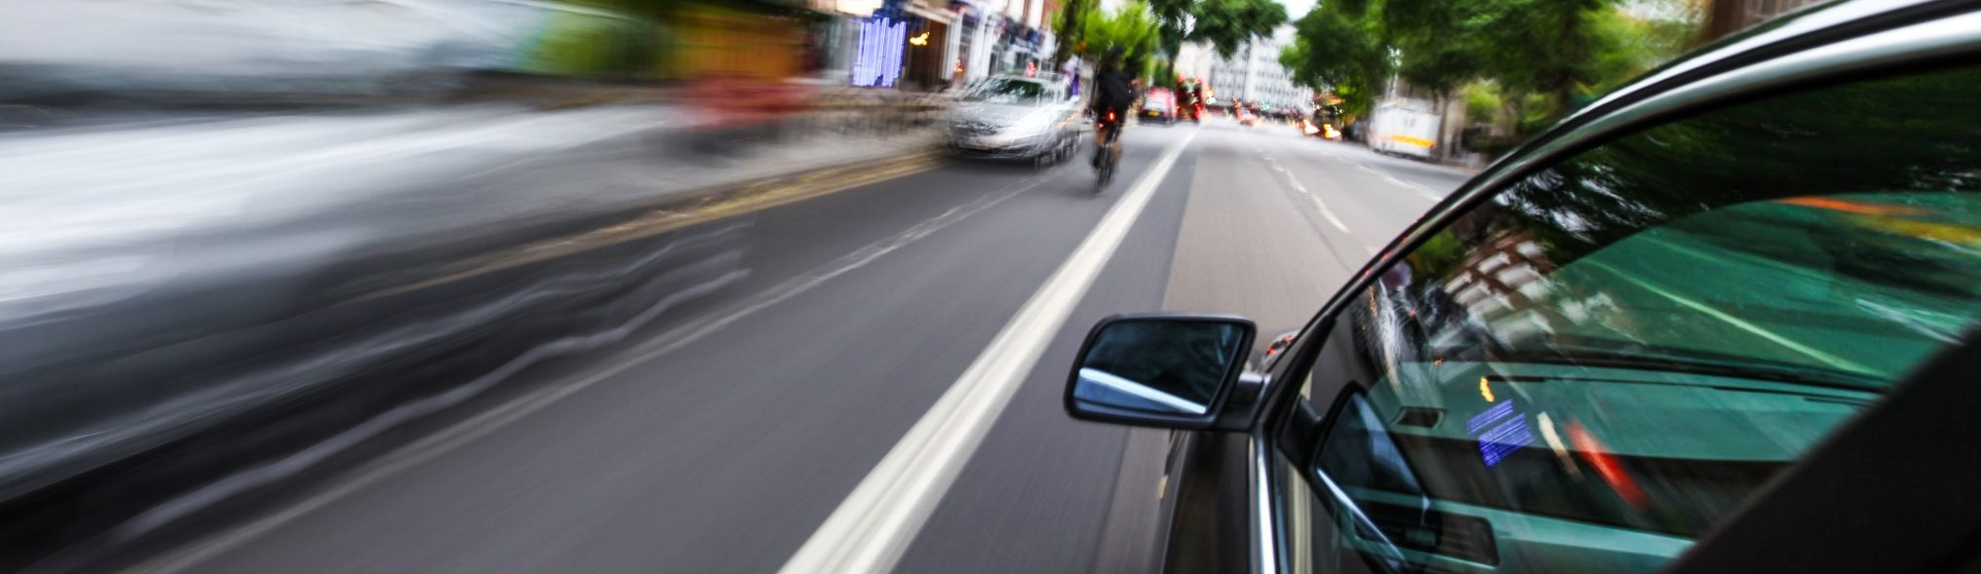
Summary: Perception vs. Reality
Factor
Perceived Benefit
Real-World Reality
Time Saved
Large and significant gains
Small (often just minutes or seconds)
Safety Risk
Underestimated or ignored
Significant increase in crash danger
Cost Impact
Rarely considered
Meaningful (fuel, wear, insurance)

Slide 9

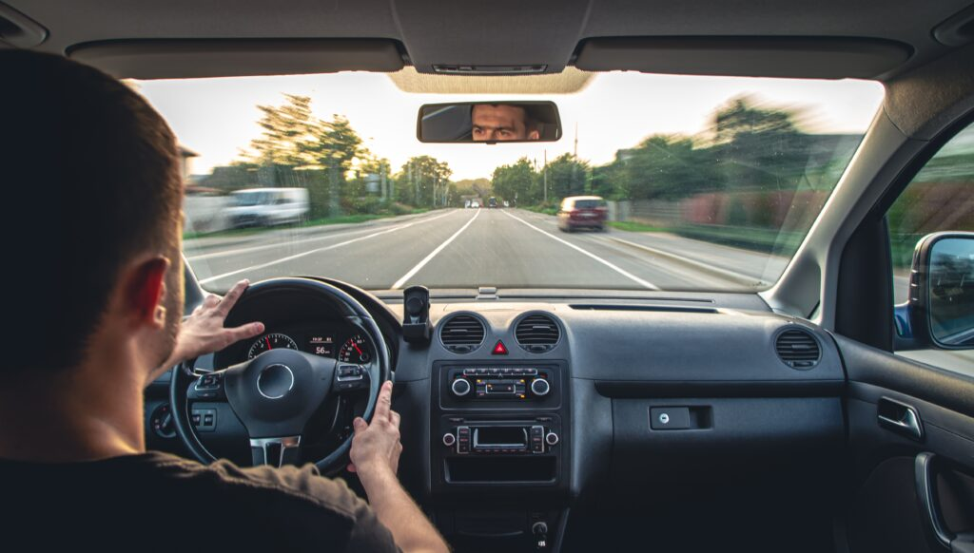
Discussion: Reflecting on
Driving Habits
Have you ever calculated how much time you really saved by speeding on a regular commute?
Consider the actual minutes gained versus the perceived effort of driving faster.
Do you think it’s worth the added crash risk for a few minutes of travel time? Why or why not?
Reflect on the exponential increase in risk for marginal time benefits.
If the average daily time savings is only 26 seconds, why does speeding feel so much more effective?
Discuss the psychological factors that create the "illusion of speed."

Slide 10
Discussion: Strategies and Messaging
How do traffic conditions (e.g., congestion) change the real benefit of speeding?
What alternatives or technologies can be used to save time without speeding?
How can public messaging better correct the misconception that “speeding saves lots of time”?

