Slide 1
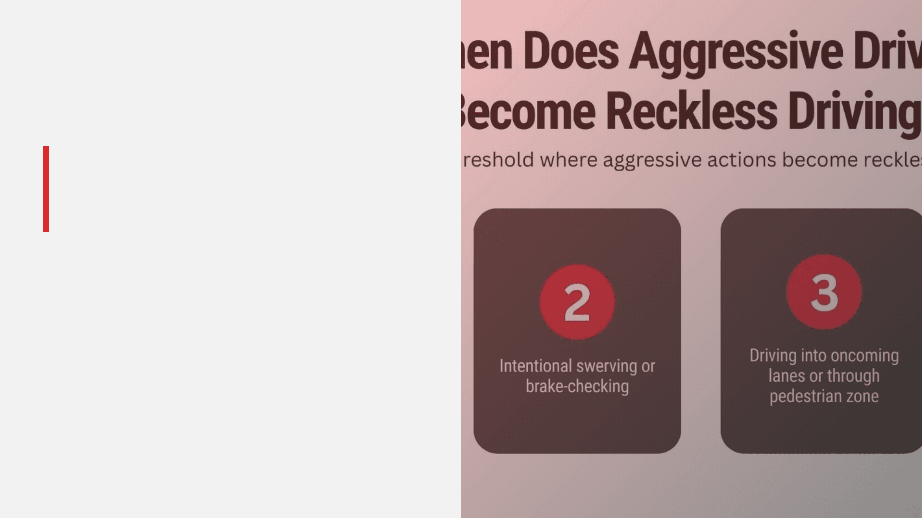
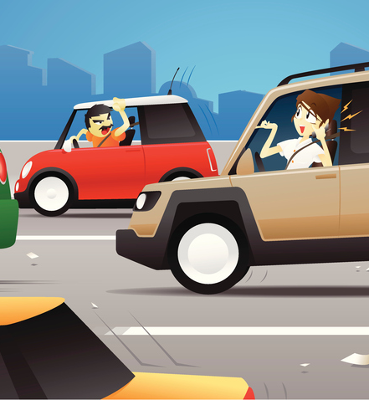
Aggressive vs. Reckless Driving
Understanding the Risks and Legal Implications of Dangerous Driving Behaviors
©2026 Fatal Vision® by Innocorp, Ltd. | www.fatalvision.com

Slide 2

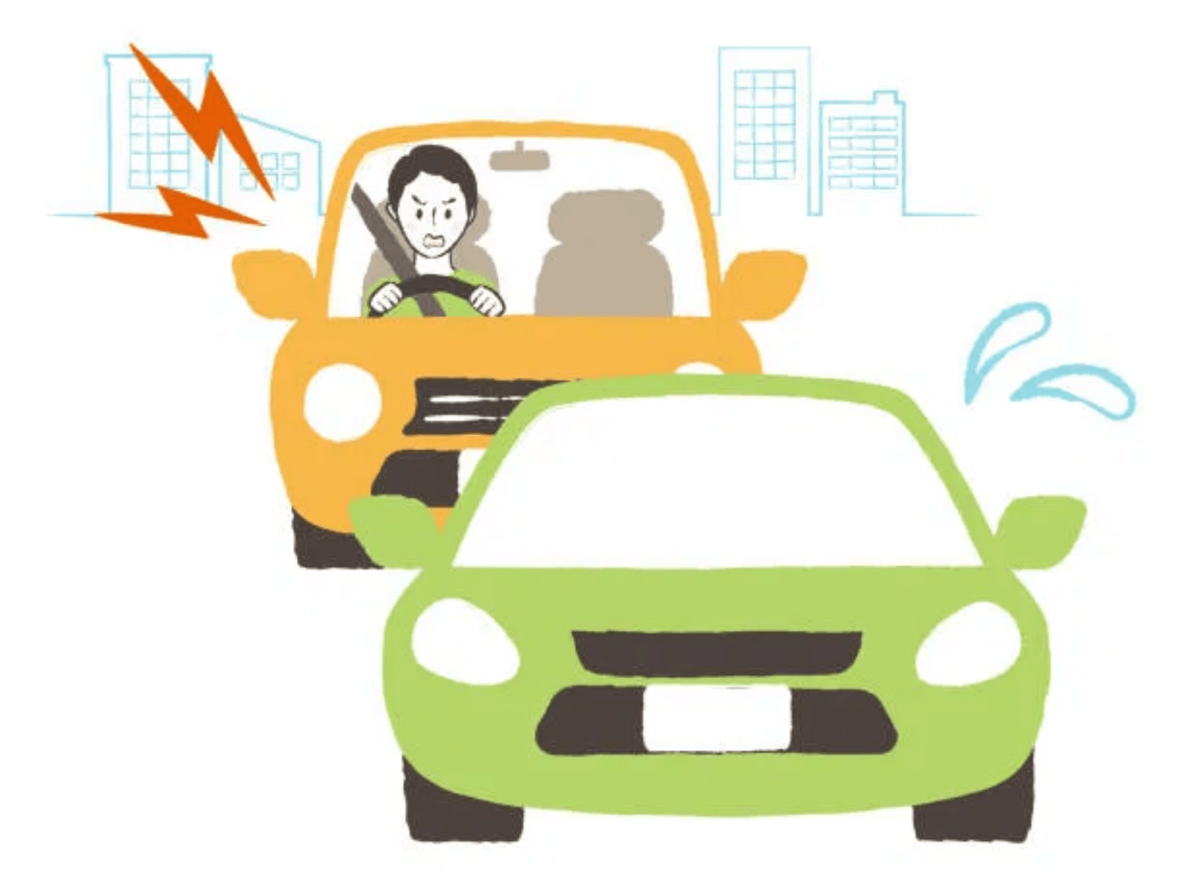
Defining Dangerous Driving
Aggressive Driving
Intentional dangerous driving behaviors that show impatience, hostility, or poor judgment, often involving traffic violations. It is typically defined as a pattern of unsafe behaviors rather than a single extreme act.
Reckless Driving
A serious offense involving willful or wanton disregard for the safety of people or property. It is typically a criminal charge indicating that the driver knowingly took extreme risks.
Key Distinction
Aggressive driving is a pattern of unsafe behaviors driven by emotion. Reckless driving is a conscious decision to ignore safety altogether.

Slide 3
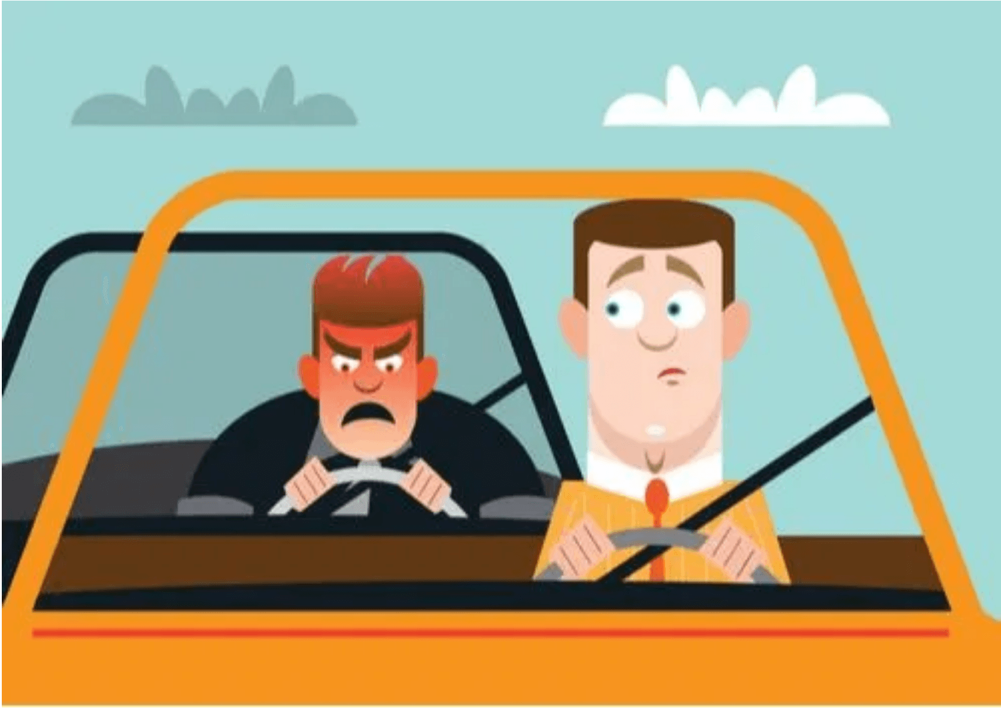
Aggressive Driving: A Pattern of Impatience
Common Dangerous Combinations:
Speeding and unsafe lane changes
Tailgating and excessive speed
Following too closely and improper passing
Failure to signal and weaving through traffic
Running a red light and accelerating aggressively
Critical Impact
Each violation alone is dangerous. Combined, they dramatically reduce reaction time, increase crash force, and put other road users at extreme risk.

Slide 4
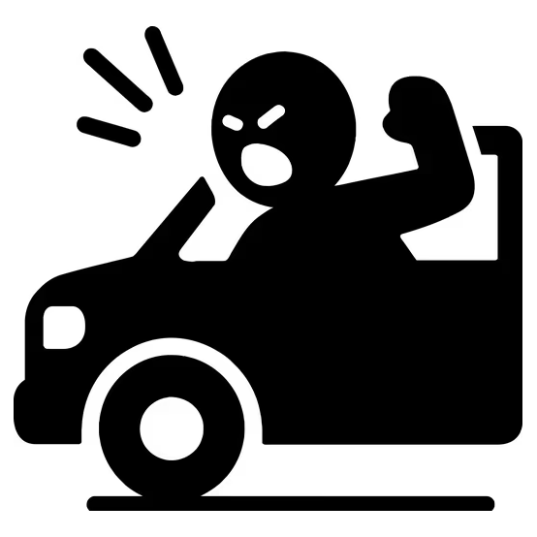
The Role of Emotion in Driving
Emotional Triggers
Anger, frustration, and impatience are the primary emotions that drive aggressive behavior on the road.
Common Emotional States:
Anger at other drivers or traffic conditions
Frustration from delays or congestion
Impatience when running late
Stress from personal or work issues
Psychological Impact
Emotions cloud judgment and lead to poor decision-making. Drivers must learn to recognize when their emotions are beginning to affect their driving style and consciously correct their behavior.

Slide 5

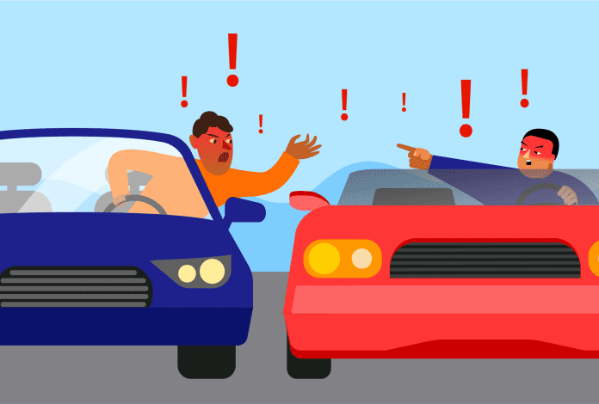
Common Examples of Aggressive Driving
Speeding
Tailgating
Driving significantly above the posted
speed limit
Following too closely to intimidate another driver
Weaving
Improper Lane Changes
Rapid lane changes through traffic without signaling
Frequent lane changes without using turn signals
Rude Gestures
Excessive Honking
Making hostile or threatening hand signals
Using the horn aggressively to express
frustration
Aggressive Acceleration
Blocking Merges
Sudden, forceful speed increases to intimidate
Intentionally preventing other vehicles from merging

Slide 6

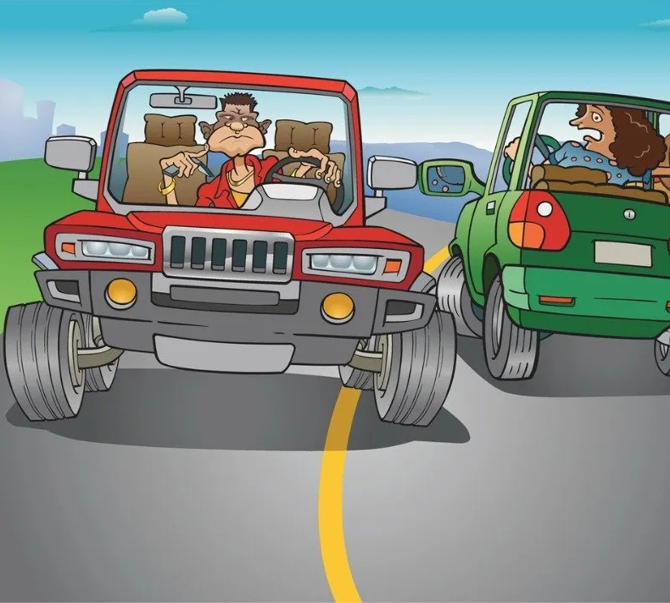
Reckless Driving: Willful Disregard for Safety
Definition
A serious offense involving willful or wanton disregard for the safety of people or property. It is typically a criminal charge indicating that the driver knowingly took extreme risks.
Key Characteristics:
Criminal Offense:
Not merely a traffic violation
Conscious Disregard:
Deliberate ignoring of safety
Extreme Risk:
Much higher likelihood of severe injury or death
Nature of Act:
Can be a single extreme act or series of dangerous maneuvers
Legal Consequences
Often results in criminal penalties, license suspension, or jail time. Significantly more severe than aggressive driving charges.

Slide 7
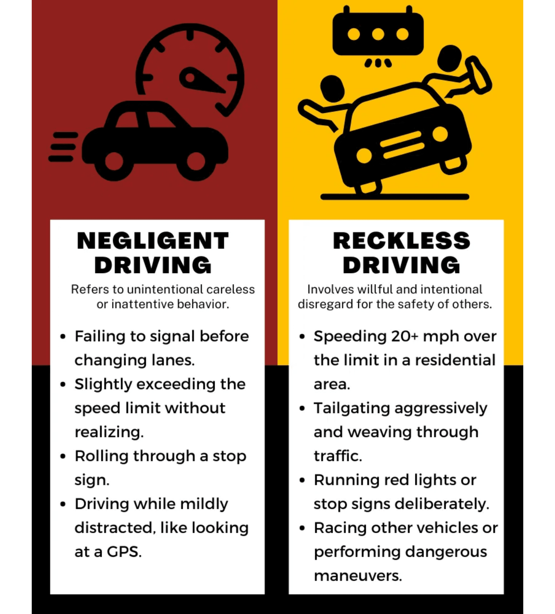
Common Examples of Reckless Driving
Street racing or racing other vehicles
Excessive speeding far above the speed limit
Running red lights at high speed
Driving on the wrong side of the road
Passing school buses illegally
Intentionally cutting off other drivers
Driving at high speed through pedestrian areas
Evading police or fleeing from law enforcement
Extreme Risk
These behaviors demonstrate conscious disregard for safety and carry much higher likelihood of severe injury or death.

Slide 8

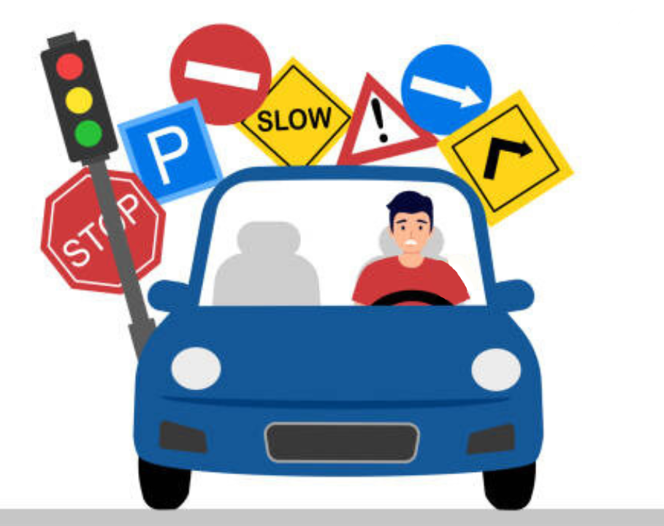
Side-by-Side Comparison
Feature
Aggressive Driving
Reckless Driving
Intent
Impatient or emotional
Willful disregard for safety
Severity
Dangerous
Extremely dangerous
Legal Status
Usually traffic violations
Often a criminal offense
Pattern
Series of unsafe behaviors
One or more extreme acts
Risk Level
High
Very high

Slide 9
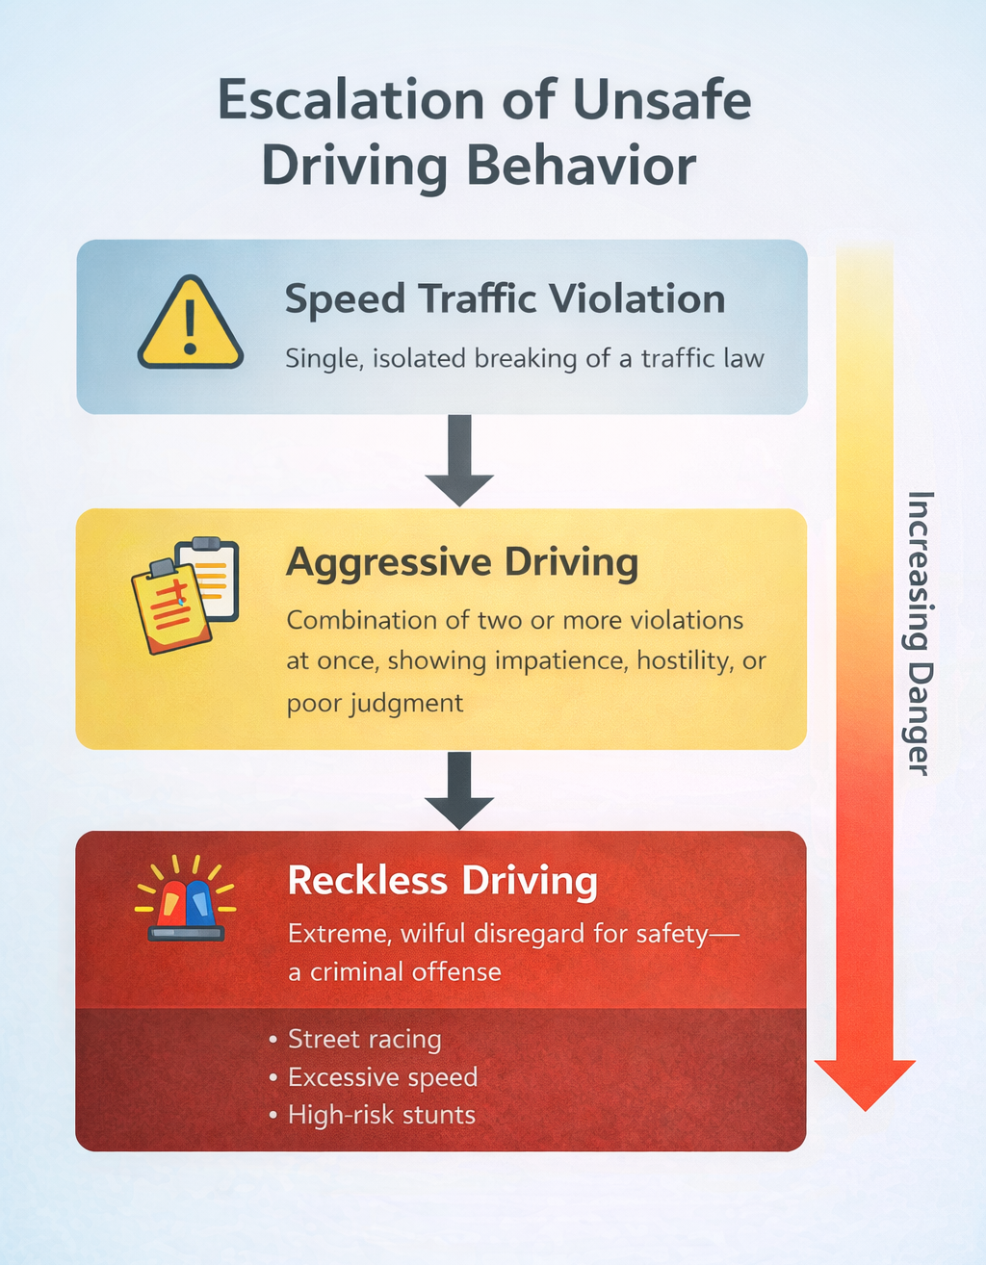
The Legal Perspective
NHTSA Definition
The operation of a vehicle in a manner that endangers or is likely to endanger persons or property, which can include a number of different moving traffic offenses.
State Law Recognition
Some states* formally recognize aggressive driving as a chargeable offense, an enhancement added when multiple violations occur together, or a precursor to
reckless driving. *Check with your own state’s laws to confirm
The Escalation Path:
Speeding only → Traffic violation
Speeding + Unsafe lane change → Aggressive driving
Speeding + Unsafe lane change + Running red light → Likely reckless driving

Slide 10

Strategies for Safety and Prevention
Avoid Engagement
Self-Recognition
Do not respond to or engage with aggressive drivers on the road.
Learn to identify when your emotions are affecting your driving.
Stay calm and avoid eye contact
Recognize signs of personal aggression
Do not make gestures or honk back
Notice increased heart rate or tension
Let aggressive drivers pass if possible
Consciously slow down and breathe
Report serious incidents to authorities
Pull over if emotions are overwhelming
Safe Practices
Planning Ahead
Maintain defensive driving habits at all times.
Reduce time pressure and stress on the road.
Maintain safe following distance
Allow extra time for trips
Use turn signals consistently
Plan routes in advance
Avoid weaving through traffic
Avoid driving when tired or stressed
Drive at or below speed limits
Take breaks on long journeys

Slide 11

Aggressive and Reckless Driving – Quiz

Slide 12
1. What is a key factor in Aggressive Driving?
Aggressive and Reckless Driving – Quiz

Slide 13
1. What is a key factor in Aggressive Driving?
Aggressive and Reckless Driving – Quiz
Impatience
Emotions

Slide 14
2. What is a key factor in Reckless Driving?
Aggressive and Reckless Driving – Quiz

Slide 15
2. What is a key factor in Reckless Driving?
Aggressive and Reckless Driving – Quiz
Criminal Offense
Deliberate ignorance or disregard for safety
One or more extreme driving acts

Slide 16
3. Why does aggressive and reckless driving reduce situational awareness?
Aggressive and Reckless Driving – Quiz

Slide 17
3. Why does aggressive and reckless driving reduce situational awareness?
Aggressive and Reckless Driving – Quiz
It narrows the driver’s focus
It reduces scanning of surroundings
It forces attention onto speed or aggression instead of hazards
It reduces time to observe and predict other drivers

Slide 18
4. What kinds of reaction errors happen more often at high speed?
Aggressive and Reckless Driving – Quiz

Slide 19
4. What kinds of reaction errors happen more often at high speed?
Aggressive and Reckless Driving – Quiz
Late braking
Braking too hard or too lightly
Oversteering or losing control
Freezing or hesitation
Choosing the wrong evasive action
Delayed decision-making

Slide 20
5. True or False?
Reckless driving only puts the driver at risk
Aggressive and Reckless Driving – Quiz

Slide 21
5. True or False?
Reckless driving only puts the driver at risk
Aggressive and Reckless Driving – Quiz
❌ False
Explanation:
Reckless driving also endangers passengers, pedestrians, cyclists, and other drivers.

